Slide 1
Exploratory Analysis – using SAs
Group 1 :
Divya Jayaprakash - dxj160830 Akshay Venkatesh - axv163930
Sumant Kekre - sxk161032 Sainanditha Venkatesh - sxv169430
Venkatasubramaniyan Balakrishnan - vxb163530

Slide 2

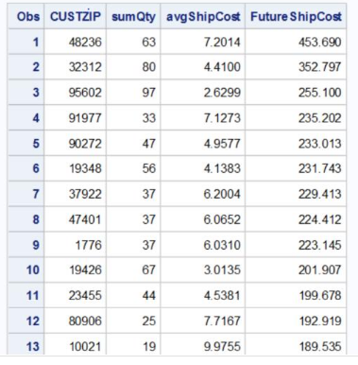
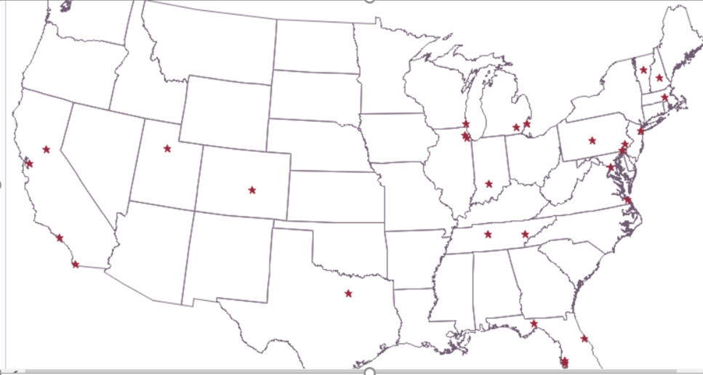
Where to open New distribution centers??
Parameter chosen:
For every zip code -> (total quantity * avg. shipping cost) is taken
Intersection!! - both factors “together” being high – best location!!
Filtered locations where Average Shipping Cost is extremely high
Found locations where number of orders is high
Multiplied both
Plotted top 30 locations that had
high shipping cost
Chose three zip codes that is centrally located
among these 30 locations
More Orders & ship cost!!
New
Dist.center needed!!
47401 BLOOMINGTON
47401 BLOOMINGTON, IN
37922 KNOXVILLE, TN
37205 NASHVILLE-DAVIDSON, TN
37205 NASHVILLE-DAVIDSON
37922 KNOXVILLE

Slide 3
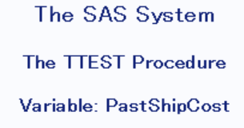
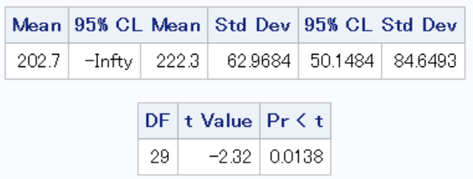
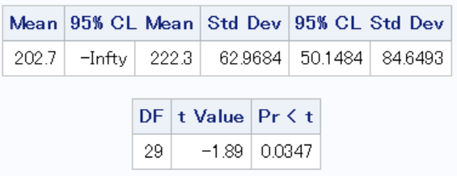

T-testS
Test 1: T-Test – one sample – left tailed µ0 : Avg ( shipping costs of all 30 locations )
229.413 : Shipping cost for zip code# 37922
H0: µ0 = 229.413
H1:µ0 < 229.413
Test 2: T-Test – one sample – left tailed
µ0 : Avg ( shipping costs of all 30 locations )
224.412 : Shipping cost for zip code# 47401
H0: µ0 = 224.412
H1:µ0 < 224.412
Test 3: T-Test – one sample – left tailed
µ0 : Avg ( shipping costs of all 30 locations )
182.976 : Shipping cost for zip code# 37205
H0: µ0 = 182.976
H1:µ0 < 182.976
Zip 37922 Chosen!!
Null hypothesis rejected
Zip 47401 Chosen!!
Null hypothesis rejected
Zip | city | state | state AB | Houses count | Population | Avg HH Income
37922 | Knoxville | Tennessee | TN | 17279 | 45667 | 37922
47401 | Bloomington | Indiana | IN | 16413 | 34589 | 54165
Avg all zips | all | all | all | 3333 | 8901 | 49067
Rejected!!
Avg ship cost of all other locations is high!!

Slide 4

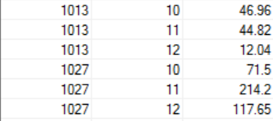
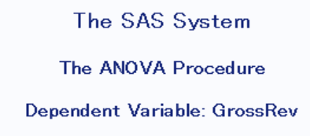
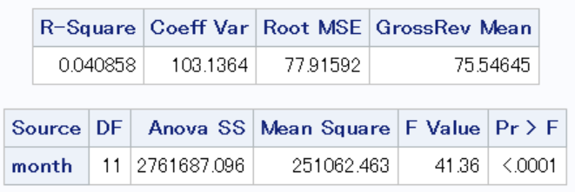
Which is the best time to introduce discount offers ???
Parameter Chosen:
For every zip code, revenue for every month taken
Strategy:
Provide discount offers in the month when the sale is dull
Steps:
Group by zip
Sub group by month
Find the total revenue for each zip-month pair
ANOVA (single factor - month): considering revenue
H0: µ(jan ) = µ(feb) = µ(mar)=.....
H1: µ(jan) <> µ(feb) <> µ(mar) <>.....
Null hypothesis is rejected
So, there is atleast one month when there is less revenue.
Avg revenue across all months are not same.
That one month shall be chosen as the best month for offers

Slide 5
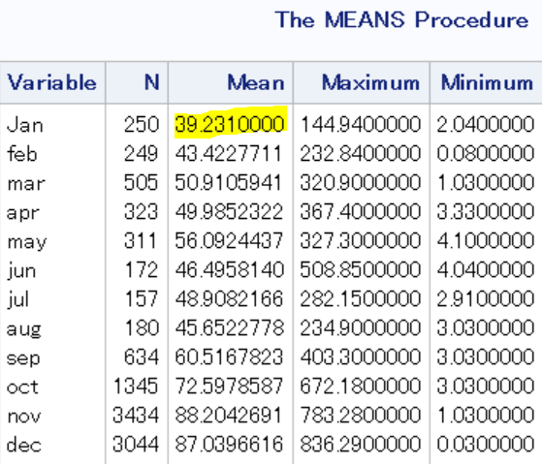
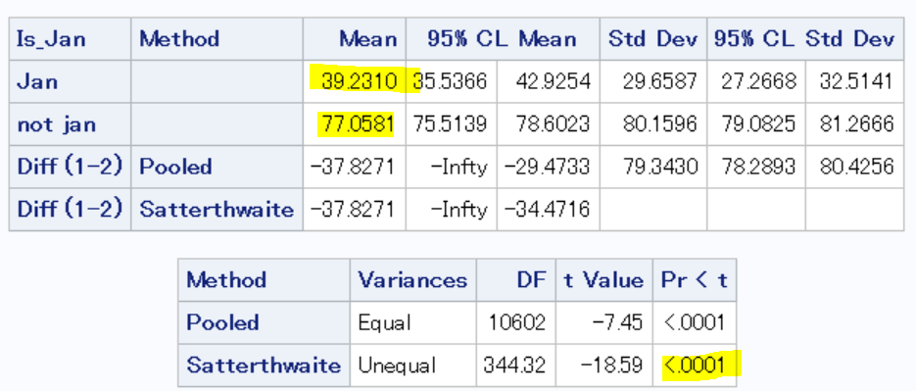
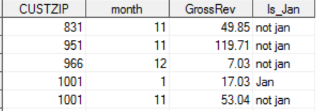
Means aND T-Test
Mean Statistics:
For every zip code, jan revenue , feb revenue, mar revenue, april revenue, etc are taken
T-Test – Two sample (jan group and all-other-month group) – Left tailed:
To check if January revenue mean is less than all other month revenue mean
H0: µ(jan) = µ(other months)
H1: µ(jan) < µ(other months)
“Jan is the best time to introduce offers and trigger sales exponentially

Slide 6
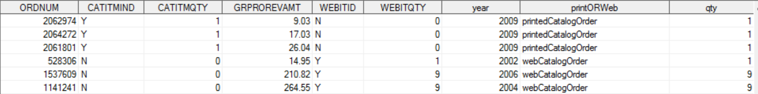
CAn the organisation do cost cutting on printed catalogue by adopting web catalogue??
How can a company save money on using web catalog using printed catalog?
Printing catalogues is expensive
Shipping it to customers is even more expensive
Periodic changes in the catalog (like inclusion of special offers etc) can be done easily only on web catalogue
There wont be a dump of unused catalog in the warehouses
Customers prefer printed catalogues because it is easy for them to choose, filter and order
Parameter chosen:
For every order-> type(printed or web catalogue order), quantity and gross amount taken

Slide 7
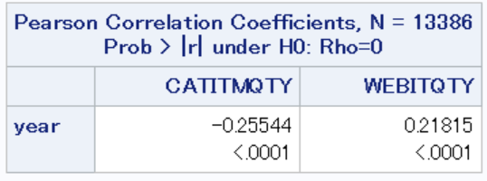
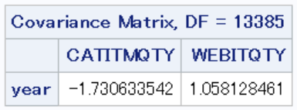
Chi- Squared test of independence between year and catalogue type used for order
Pearson Correlation:
year increases -> printed catalogue order quantity decreases
year increases -> web catalogue order quantity increases
Organisation can confidently switch their investment plan from print catalogue to web catalogue-
that will be lot of cost cutting for them

Slide 8

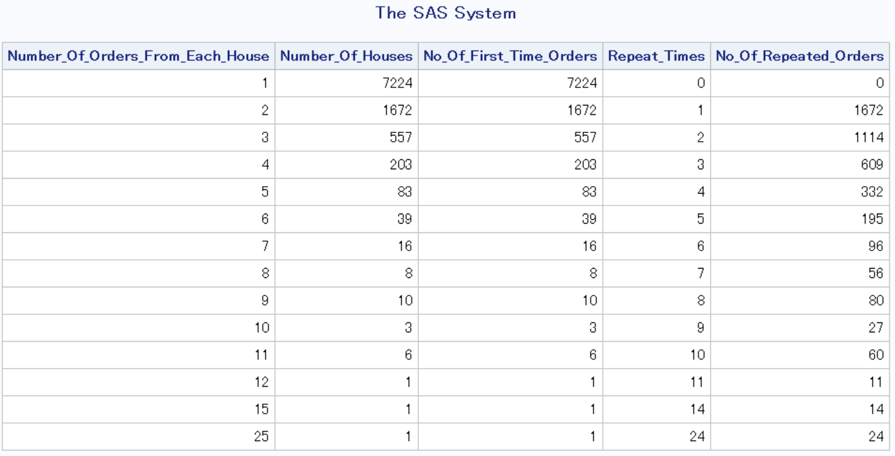
ARE OUR customers satisfied ??
Parameters chosen to evaluate customer satisfaction
Probability of a customer placing orders again after the first time order
Order return percentage per year
Case 1: Probability of customers placing orders repeatedly
Total NO. Of Repeated Orders from the same customers = 4290
Total No. Of First Time Orders = 9824
P(Repeated orders given first time orders) = (4290/9824)*100 = 43.67%
The probability of a customer ordering again after the first time order = 43.67%

Slide 9
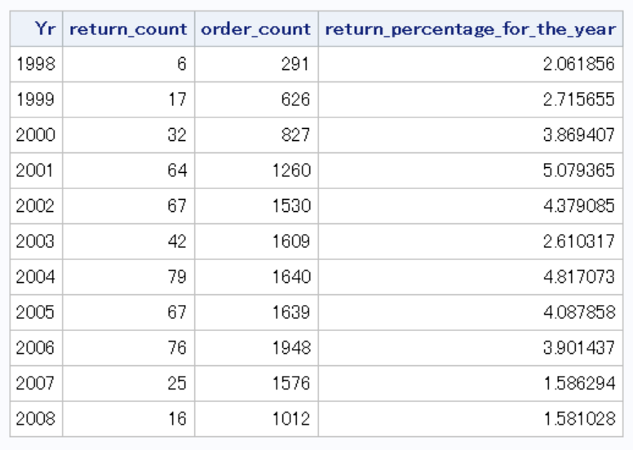
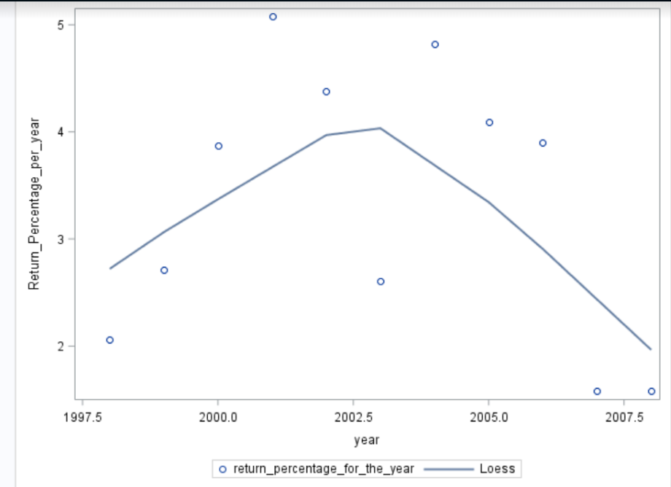
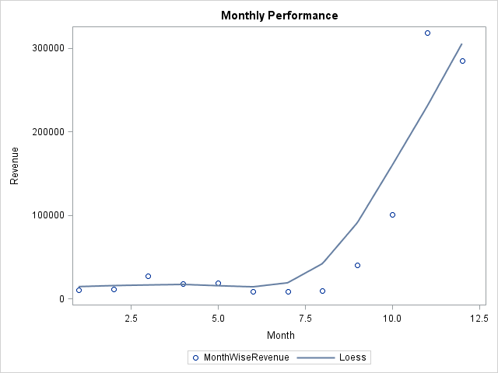
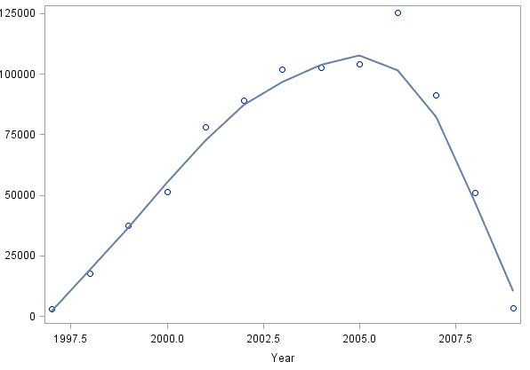
Also WHEN ARE the company’s HIGH AND LOWS ??
Case 2: Order return percentage per year
Q-4 records 82% of our revenue
Company’s revenue reached its peak in 2006
70% of our average sales occur in November and December
Between years 1998 – 2008 the return percentage has decreased
Return percentage went up to 5% in 2001 but again the company could recover drastically
Recent Years 2007 and 2008 saw a decreased and almost constant return percentage of 1.5%
This indicates that the company constantly worked towards improving its customer satisfaction

Slide 10


Executive Summary
New distribution centre cum warehouse to be established at
47401 Bloomington, IN
or
37922 Knoxville, TN
Special discount offers introduced to trigger sales in the January month exponentially
Web catalogue advertising should be focussed more than the printed catalogue as a measure of cost cutting

